Slide 1
Data Structure
Programming Project #4
郭建志

Slide 2
Imagine
You want to test whether an element is a member of a set
In the set → return true
Not in the set → return false
You don’t need exact results
That is, some false positives are allowed

Slide 3



Usage
Ticket booking
Matchmaking
Dating services
Source:
https://tixcraft.com/activity/detail/20_MAYDAY
https://en.wikipedia.org/wiki/FIFA_21
https://en.wikipedia.org/wiki/Tinder_(app)

Slide 4
Problem
Given:
Keys that are input in sequence
Goal
Check whether the key has been examined
Bounded error is allowed
Constraint:
Limited storage and limited computation

Slide 5
Simple Solutions
Construct a set of elements
Implement a binary search tree in C
Use a balanced binary tree: set in C++
Hash table: unordered_map in C++
You may want to use libraries Guava or FastUtil in Java for convenience and better performance

Slide 6
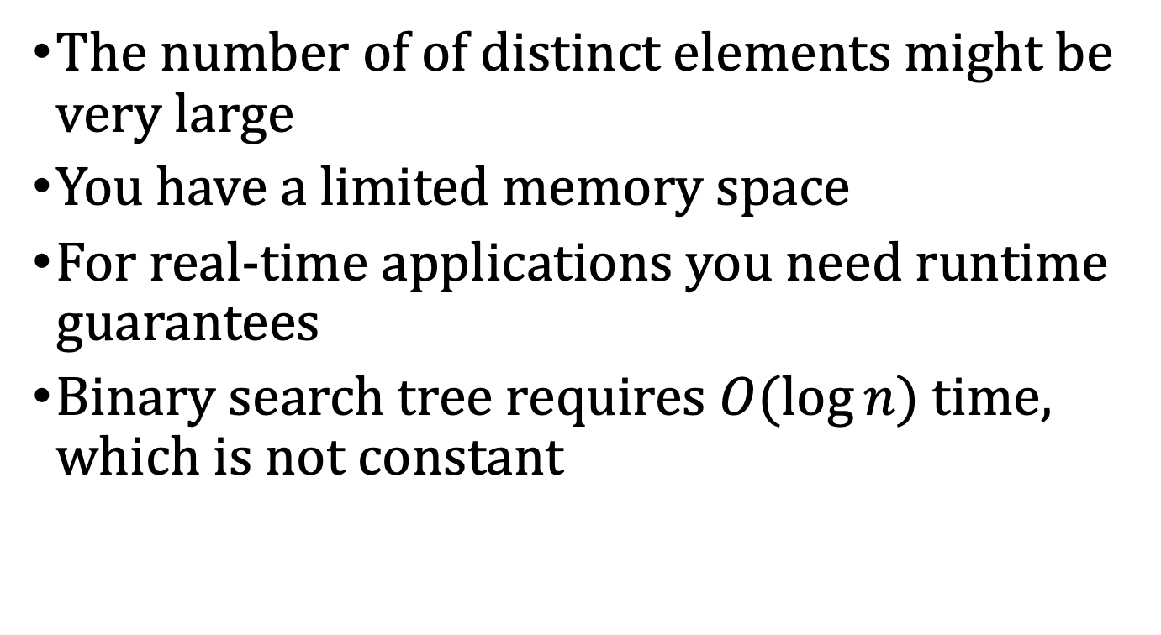
Problem
The number of of distinct elements might be very large
You have a limited memory space
For real-time applications you need runtime guarantees
Binary search tree requires $O(log⁡n)$ time, which is not constant

Slide 7
Solution: The Idea of Bloom Filter
The trick: don’t store the distinct elements, but just a fixed number of bits
Create a bit array of length x initially filled with false values (or 0s)
Each incoming element gets mapped to a number (i.e., an index) between 0 and x
The corresponding bit in the array is set to true
To query an element’s bit, simply return the bit value at it’s position

Slide 8
Solution: The Idea of Bloom Filter
The trick: don’t store the distinct elements, but just a fixed number of bits
Create a bit array of length x initially filled with false values (or 0s)
Each incoming element gets mapped to a number (i.e., an index) between 0 and x
The corresponding bit in the array is set to true
To query an element’s bit, simply return the bit value at it’s position
You are completely right: There will be collisions!

Slide 9
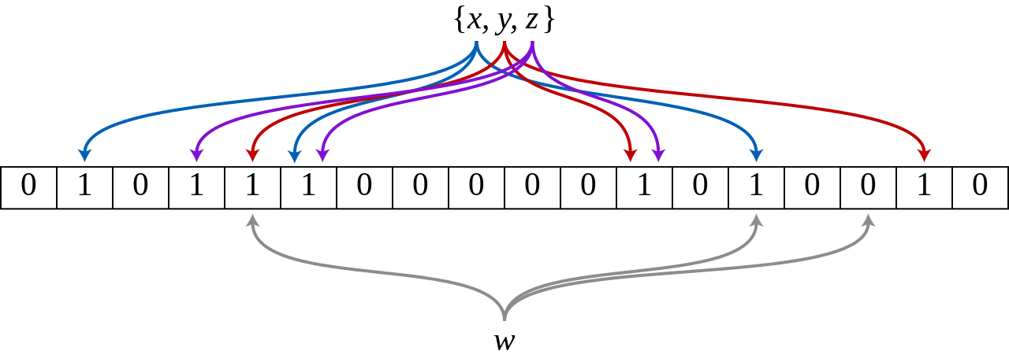
Solution: Bloom Filter
Use multiple hash functions to compute the indices of multiple positions for each element
When w is queried, return true if all the bits are true

Slide 10
Solution: Bloom Filter
Use multiple hash functions to compute the indices of multiple positions for each element
When w is queried, return true if all the bits are true
You are completely right: There will still be collisions!

Slide 11
Solution: Bloom Filter
Use multiple hash functions to compute the indices of multiple positions for each element
When w is queried, return true if all the bits are true
You are completely right: There will still be collisions!
… but less

Slide 12
Some properties
Only false positive, never false negative
Has a constant memory and time consumption independent of the number of elements
Has a lower false positive rate compared to the method with only one hash function

Slide 13
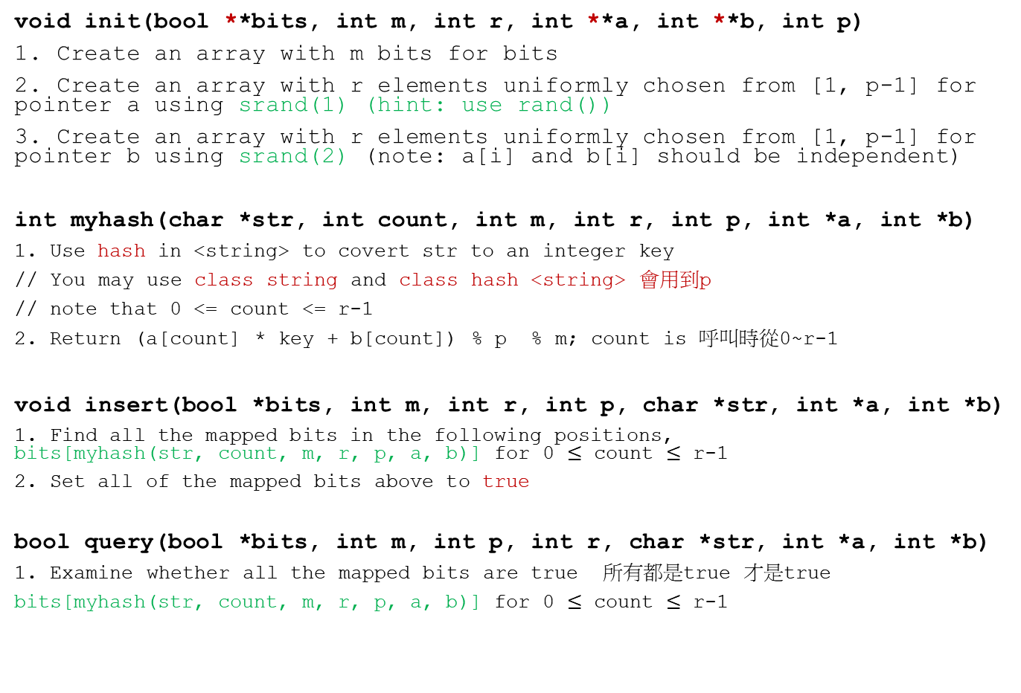
You need to implement:
void init(bool **bits, int m, int r, int **a, int **b, int p)
1. Create an array with m bits for bits
2. Create an array with r elements uniformly chosen from [1, p-1] for pointer a using srand(1) (hint: use rand())
3. Create an array with r elements uniformly chosen from [1, p-1] for pointer b using srand(2) (note: a[i] and b[i] should be independent)
int myhash(char *str, int count, int m, int r, int p, int *a, int *b)
1. Use hash in <string> to covert str to an integer key
// You may use class string and class hash <string> 會用到p
// note that 0 <= count <= r-1
2. Return (a[count] * key + b[count]) % p % m; count is 呼叫時從0~r-1
void insert(bool *bits, int m, int r, int p, char *str, int *a, int *b)
1. Find all the mapped bits in the following positions, bits[myhash(str, count, m, r, p, a, b)] for 0 $≤$ count $≤$ r-1
2. Set all of the mapped bits above to true
bool query(bool *bits, int m, int p, int r, char *str, int *a, int *b)
1. Examine whether all the mapped bits are true 所有都是true 才是true
bits[myhash(str, count, m, r, p, a, b)] for 0 $≤$ count $≤$ r-1

Slide 14
Input Sample
#bits #hash_function #words #tests #prime
word1
word2
Word3
…
test1
test2
…
M=50 r=10 10 3 1019
data
structures
serve
as
the
basis
for
abstract
data
type
type
data
object

Slide 15
Output Sample
type: true
data: true
object: false
test1: bool
test2: bool
test3: bool
…
Note: The bool values are allowed to have partial errors to some extent, since you are using a bloom filter instead of a binary search tree

Slide 16
Note
Superb deadline: 12/31 Thu
Deadline: 1/7 Thu
You are not allowed to use ”class” in STL to count the words
You must implement a bit-array with the given size (i.e., #bits of input) to count the words
E-course
C++ Source code (but only use C code unless hash < string>)

